Slide 1
Clothes Size Prediction Using Machine Learning
Sayali Rajendra Kambli
2010910

Slide 2
Introduction
Online shopping has always been time saving and efficient. In this pandemic it has become more helpful.
People who are new to online shopping might face size problem.
Even this might be issue to regulars.
Size chart provided by shopping site have many lengths to measure.

Slide 3
Dataset
Data set has 119734 rows with 4 columns/variables:
Weight of a person - in Kg
Age of a person - in Years
Height of a person - in cm
Size of Clothes - ['XL' 'L' 'M' 'S' 'XXS' 'XXXL' 'XXL']

Slide 4
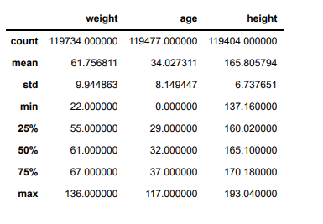
Data Summary

Slide 5
Cleaning data set
Deleted some rows from dataset having less age values.
Deleted rows having NA values.

Slide 6
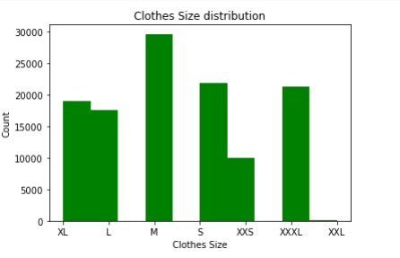
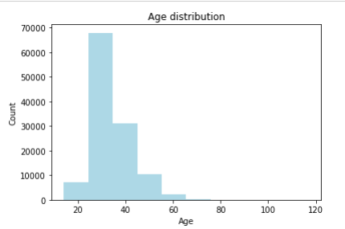
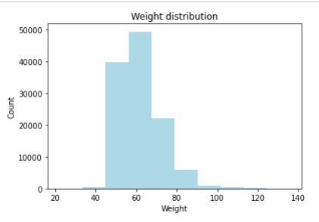
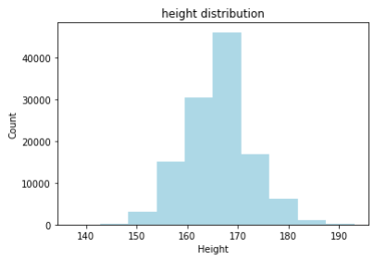
Distribution of variables

Slide 7
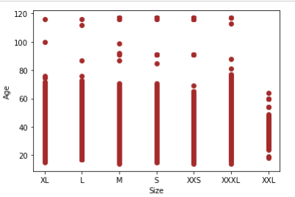
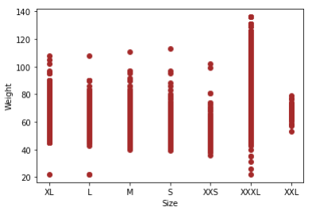
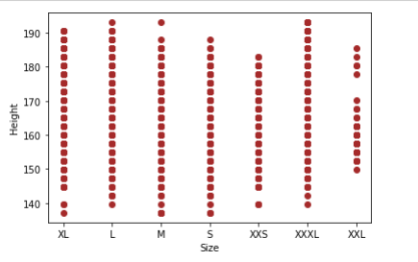
Relationship with Target variable

Slide 8
Splitting the dataset
Count of Training data set: 89328
Count of Testing data set: 29776

Slide 9
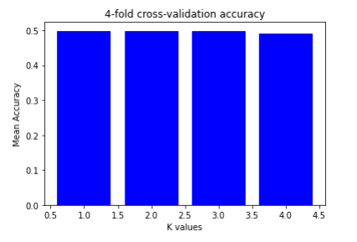
1. Logistic Regression
Logistic Regression is giving 50% accuracy on test and train data.
Mean performance by Logistic Regression is: 49.58

Slide 10
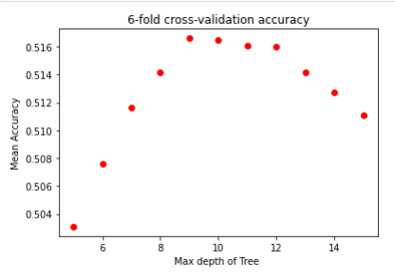
2.Decision Tree Classifier
Accuracy of Decision Tree Classifier on test data: 0.5128
Average accuracy is still coming around 51%.

Slide 11
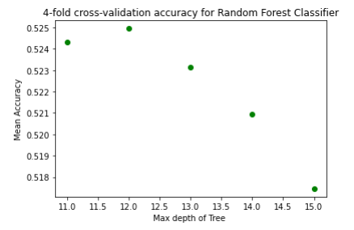
3. Random Forest Classifier
Accuracy of Random Forest Classifier on test set: 0.512
OOB score: 0.509

Slide 12
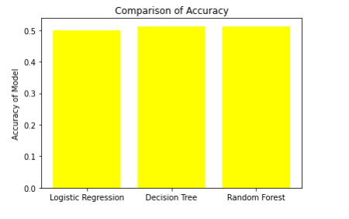
Conclusion

Slide 13
References:
https://moodle.essex.ac.uk/course/view.php?id=15076&section=10
https://realpython.com/logistic-regression-python/
https://www.kaggle.com/tourist55/clothessizeprediction

